Slide 1
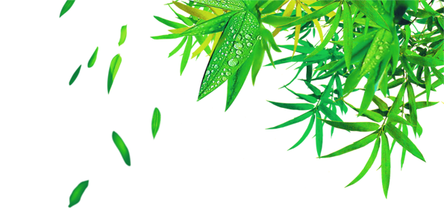

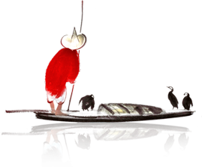
The Dragon Boat Festival
六一班 秦子皓

Slide 2
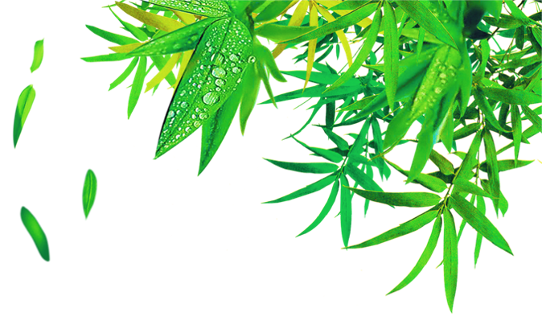
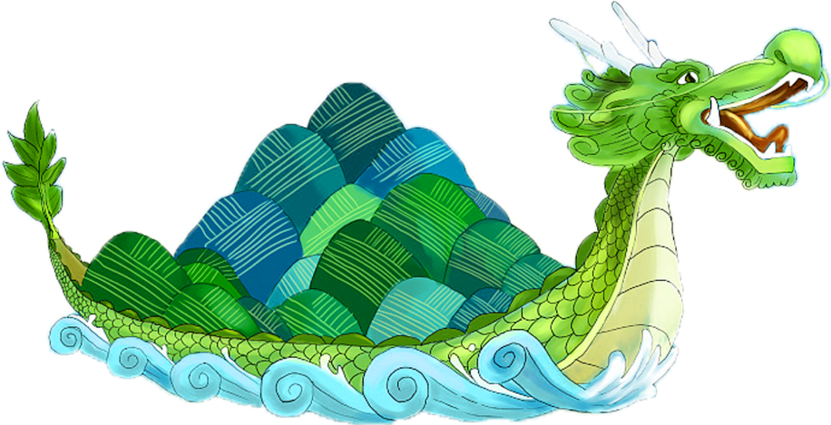
Origin of Dragon Boat Festival
端午的由来
1
Custom of Dragon Boat Festival
端午的习俗
2

Slide 3
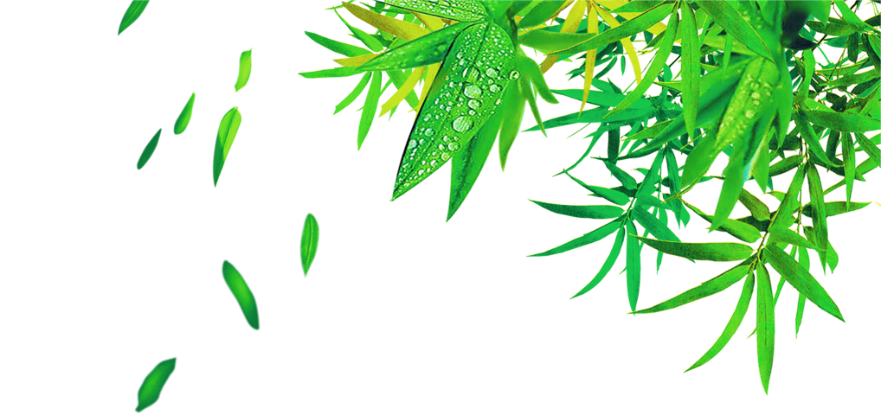
Origin of Dragon Boat Festival

Slide 4
THE INTRODUCTION
The Dragon Boat Festival,also called the Duanwu Festival,is celebrated on the fifth day of the fifth month according to the Chinese calendar. This festival is to commemorate the death of Qu Yuan.

Slide 5
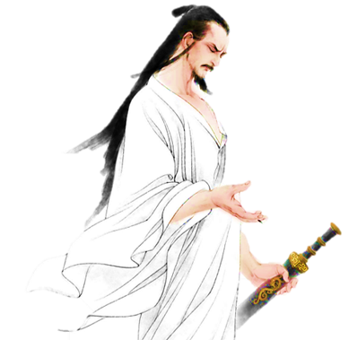
HISTORY
The Dragon Boat Festival, the 5th day of the 5th month in the Chinese lunar calendar, has had a history of more than 2,000 years. It is usually in June in the Solar calendar.

Slide 6
Custom of Dragon Boat Festival

Slide 7
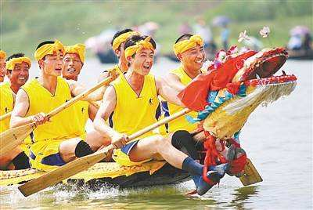

Hanging Pictures of Zhong Kui
The Culture of Zongzi

Slide 8
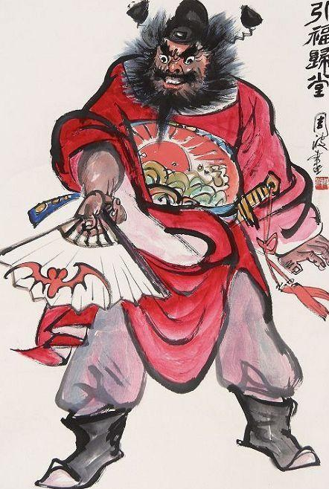
Hanging Pictures of Zhong Kui
Zhong Kui is right in the south. In Chinese folklore, God can drive away evil spirits. In the old days, Chinese folk often hung Zhong Kui's image to ward off evil spirits and eliminate calamity.

Slide 9
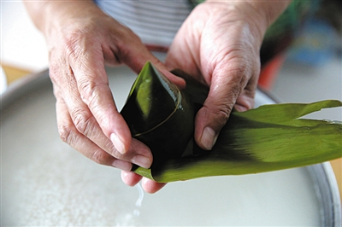
Zongzi is a traditional custom of the Dragon Boat Festival. First of all, prepare the zongzi leaves. The zongzi leaves of the old Beijing dumplings are usually reed leaves. They are called Zongye leaves on the dumplings. Next is to prepare the stuffing in the dumplings, put the stuffing in the leaves of zongzi, and the rice dumplings are finished.
The Culture of Zongzi

Slide 10

The Dragon Boat Festival

